Slide 1

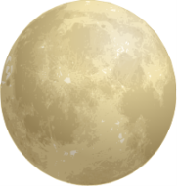
F_{g}
Δr

Slide 3
F_{e}
Δr

Slide 5
F_{e}
Δr

Slide 7
E
p

Slide 9
Before
v
79q_{e}
2q_{e}
After
v
79q_{e}
2q_{e}

